Slide 1
“Advancing the Kingdom and Holding Ground”
Lessons for TCF from the Book of Joshua
Joshua 3:1-4:18
“Importance of Presence”
By Phil Grove 27th July 2025

Slide 2
Today’s Agenda!
Brief Recap
Follow the Presence
Consecrating ourselves
Going into new things.
The Importance of Presence
Intentional Memory Markers

Slide 3
Recap
The Importance of Miracles
Warfare under the Old Covenant and the New Covenant
New leaders for doing new things
3 Things to Avoid
Disobedience to God’s Commands
Failing to Seek God’s Advice:
Forgetting God’s Miracles and Provision
Joshua as a type of Christ Jesus

Slide 4
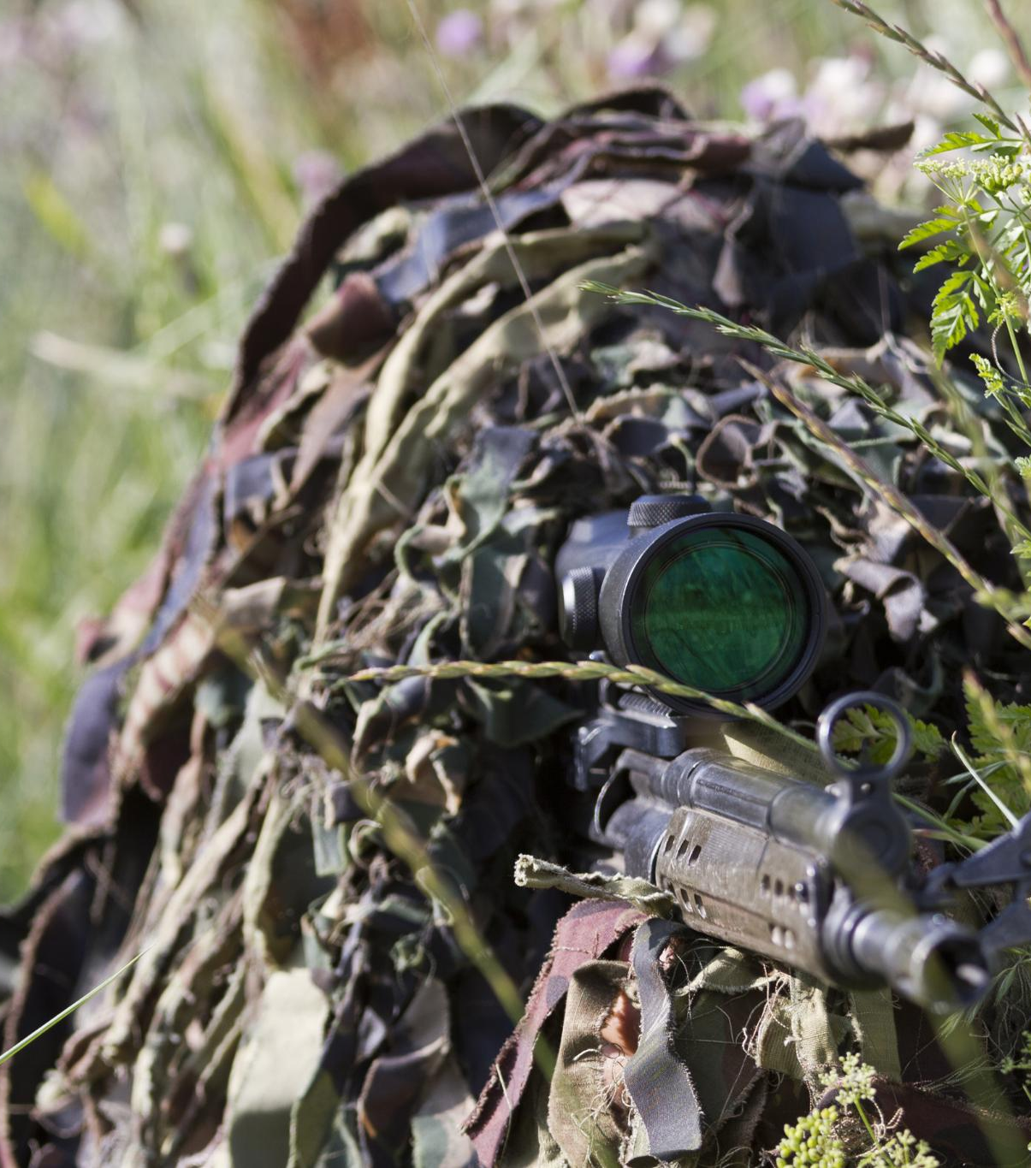
Recap
Spying out the New Opportunities
Strategy: Military not Management
Rahab/Person of Peace
Rules of Engagement
Prepared
Forgiven, No Hang ups
Pray for each other
Resist
Fitness
Proactive

Slide 5
Follow the Presence
The ark was the presence of God.
Today where does God dwell?
God’s word, His Praises and Church
Notes:
But not too near
2 Tin 3:16-17 All Scripture is breathed out by God and profitable for teaching, for reproof, for correction, and for training in righteousness, ¹⁷ that the man of God^{[a]} may be competent, equipped for every good work.
Ps 22:3 Yet you are holy, enthroned on the praises of Israel.*Or dwelling in the praises.
Eph 1:22 And he put all things under his feet and gave him as head over all things to the church, ²³ which is his body, the fullness of him who fills all in all.

Slide 6
Feet
Jos 1:3 I will give you every place where you set your foot, as I promised Moses.
Take your shoes off (Burning bush)
Miss Steps (eg Peter walking on water)
Foot Washing eg John 15
Feet shod with the readiness of the Gospel of Peace

Slide 7
Consecrate Ourselves
Speaking up
Seeking God
Sacrificing, Pruning
Special to Him

Slide 8
New Things
We need miracles to go to new places.
Even Manna got taken for Granted
God is working already and calls us to join in.
The Lord wants to work with us, not do for us.
In our weakness He is strong

Slide 9
The Importance of Our Presence
Engaging
Investing
Earning the authority
Incarnational

Slide 10
Intentional Memory Markers
Journaling
Curate Photos
Souvenirs
Passing on to the next Generation

